Slide 1
THIS COLLECTION HAS BEEN DEVELOPED TO IMPROVE
THE GRAPHIC STYLE OF JIACI
Please do not use it for publications in other books or journals that are not owned by JIACI.

Slide 2


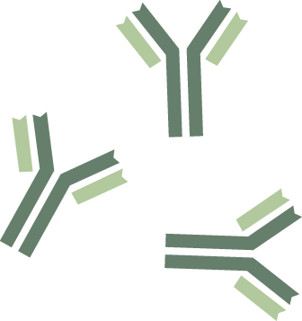
B CELL
REGULATORY B CELL
EFFECTOR B CELL
B CELL
BREG
Beff
B CELL
BREG

Slide 3


T CELL
Th0
Th1
Th2
Th9
Th17
Th22
Th25
Th31
Th33
T reg
T cell

Slide 4


TLR CELL
TLR1
TLR2
TLR3
TLR4
TLR5
TLR6
TLR7
TLR8
TLR9

Slide 5






GROUP 1 ILC
GROUP 2 ILC
GROUP 3 ILC
NATURAL KILLER CELL
CYTOKINES
ILC1
ILC2
NK
ILC3

Slide 6




EOSINOPHIL
NEUTROPHIL
BASOPHILS

Slide 7
MONOCYTE
MACROPHAGE
CLASSICALLY-ACTIVATED (M1)
ALTERNATIVELY-ACTIVATED (M2)
MO
M1
M2

Slide 8
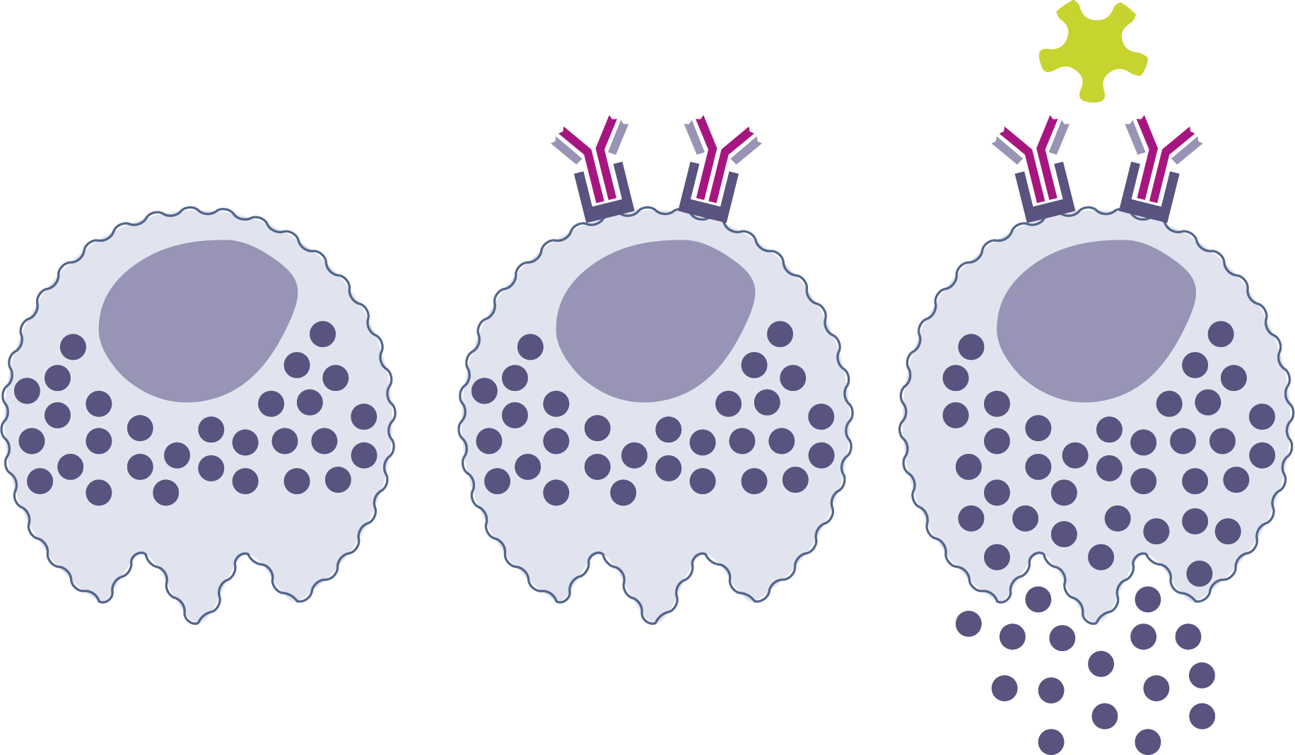
MAST CELLS
MC
MC
MC

Slide 9
PLASMATIC CELLS
PROTEIN
MC

Slide 10




DENDRITIC CELL
CONVENTIONAL DC1/DC2
PLASMACYTOID DC
LANGERHANS CELL
T FOLLICULAR CELLS
DC
cDC2
pDC
LC
Tfh
cDC1

Slide 11
NORMAL EPITHELIAL CELL
GOBLET CELL
DAMAGED EPITHELIAL CELLS

Slide 12
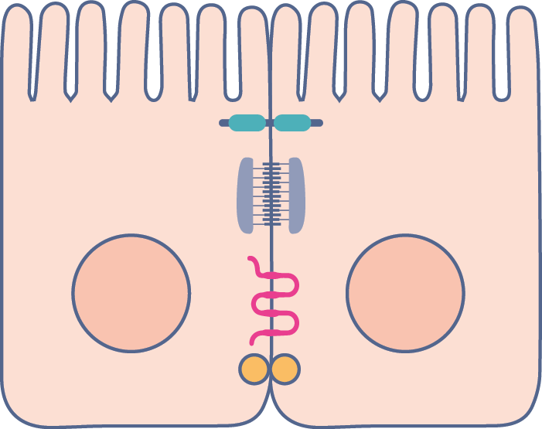
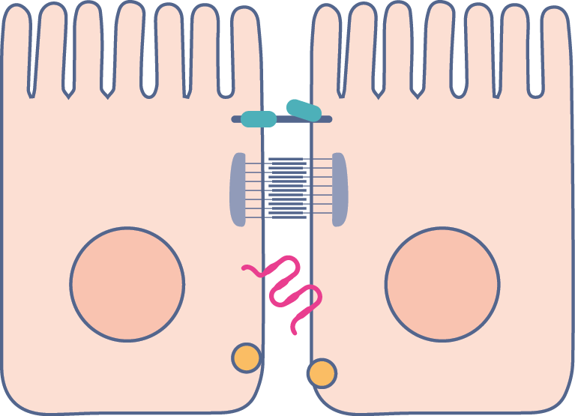
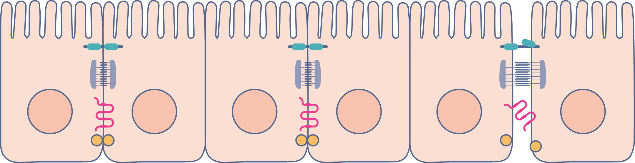
NORMAL TIGHT JUNCTIONS
DISRUPTED TIGHT JUNCTIONS

Slide 13

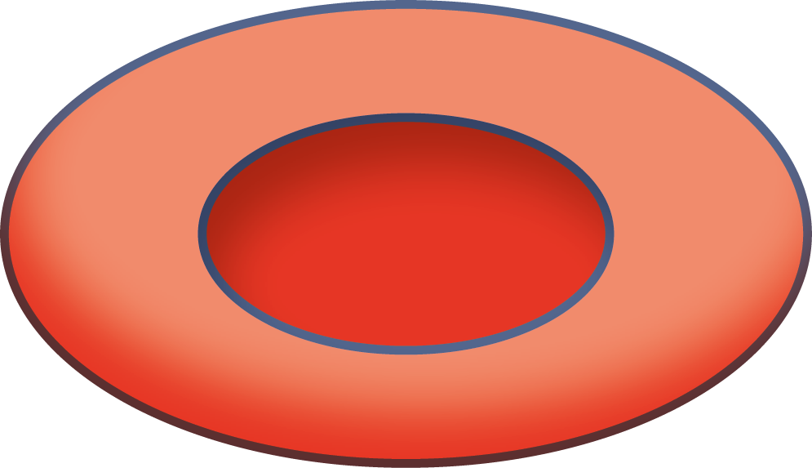

FIBROBLAST /FIBROCYTE
SMOOTH MUSCLE CELLS
ERYTHROCYTE
PLATELET

Slide 14
BLOOD VESSEL
ENDOTHELIAL CELL

Slide 15
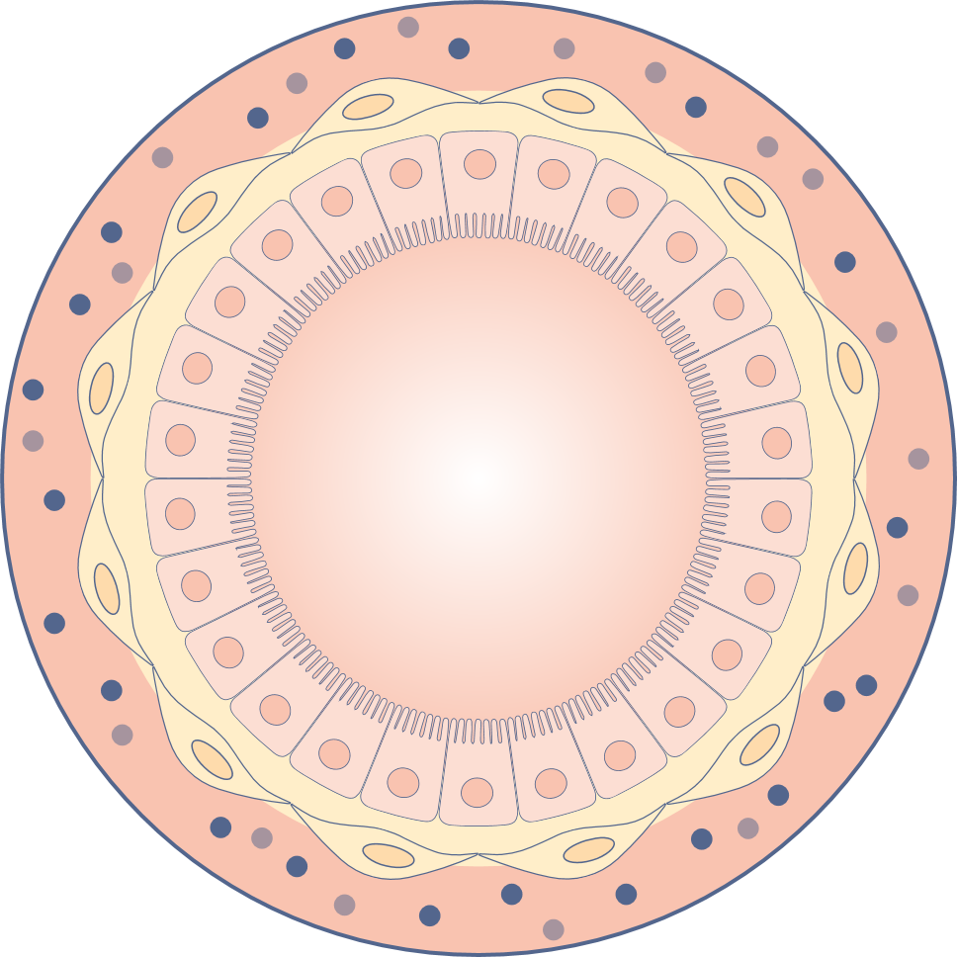
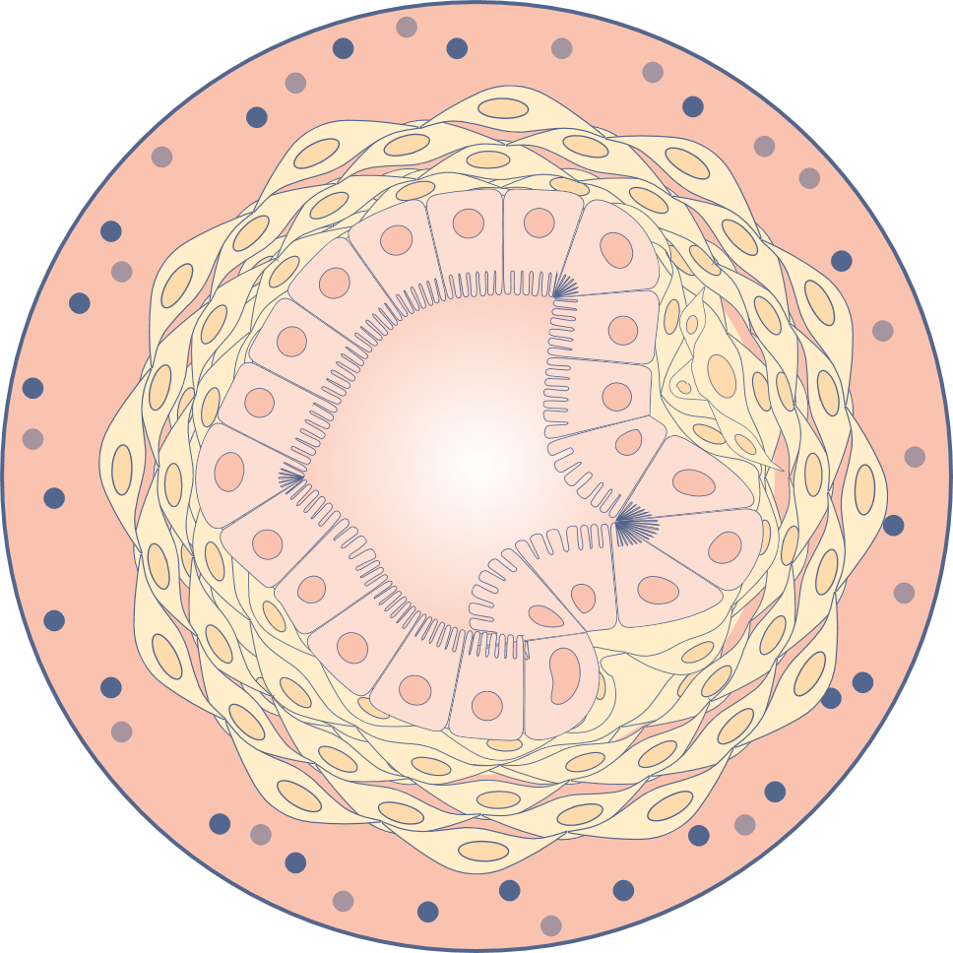
NORMAL BRONCHUS
ASTHMATIC BRONCHUS

Slide 16

IgE
IgA
IgG
IgM

Slide 17
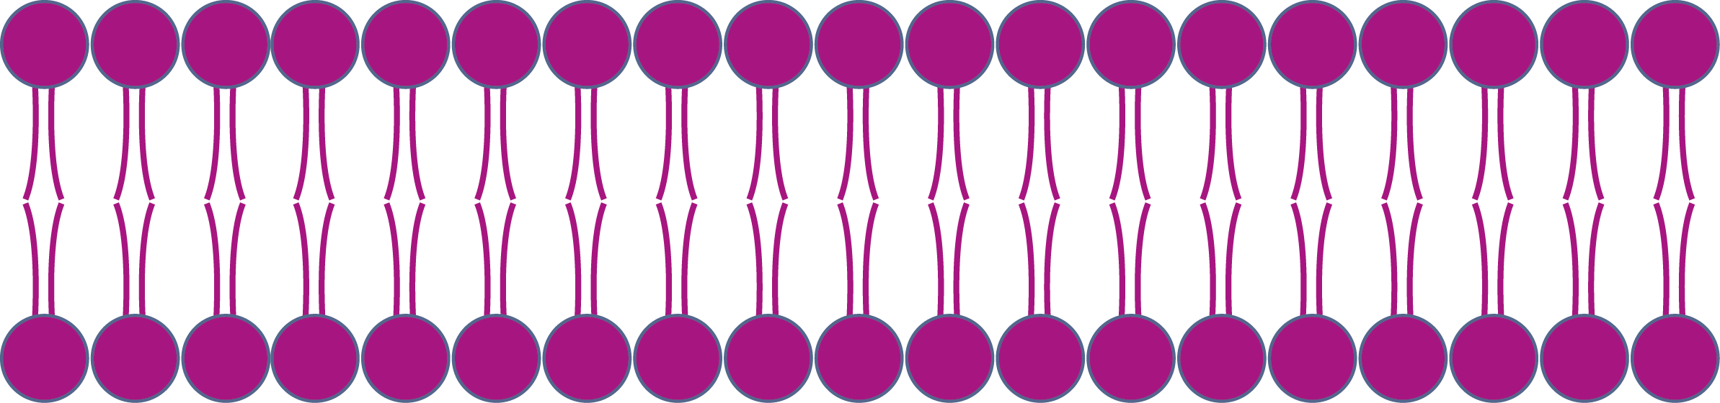
CELL MEMBRANE

Slide 18

G PROTEIN-COUPLED RECEPTOR (GPCR)
INTRACELLULAR ADHESION MOLECULE-1 (ICAM-1)

Slide 19


G PROTEIN-COUPLED RECEPTOR (GPCR)
T cell

Slide 20



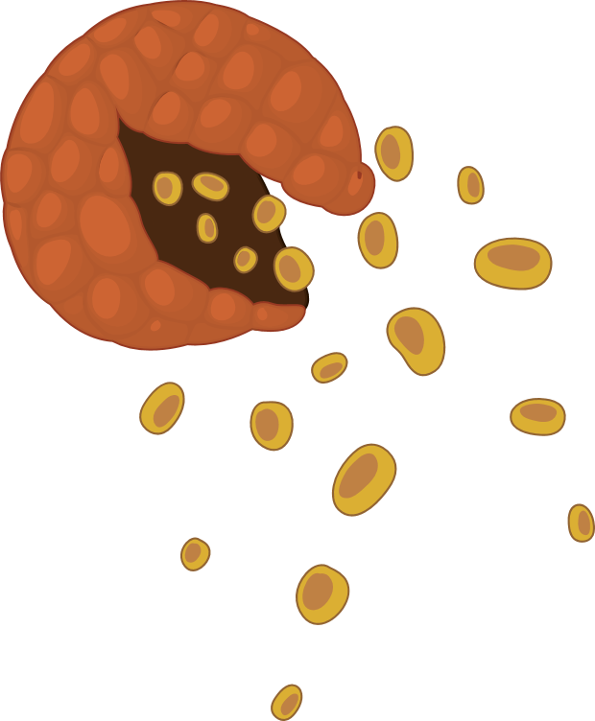
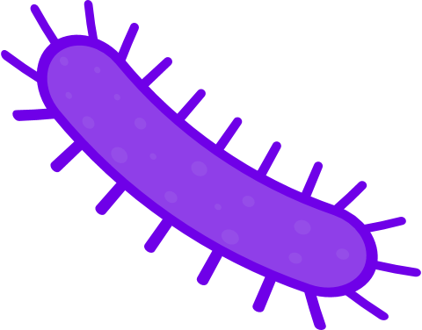
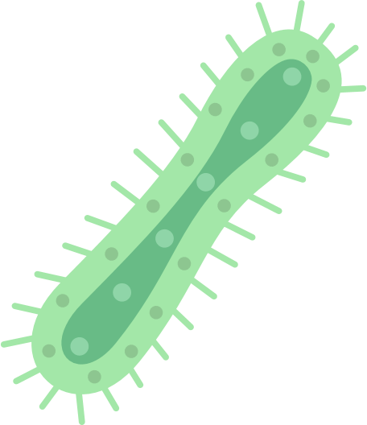
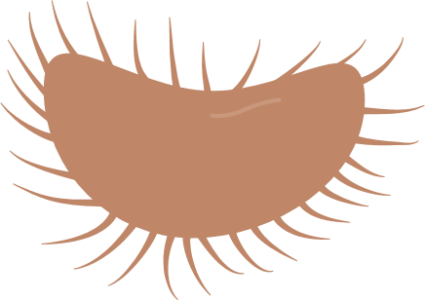

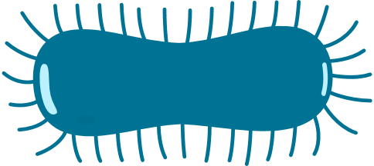
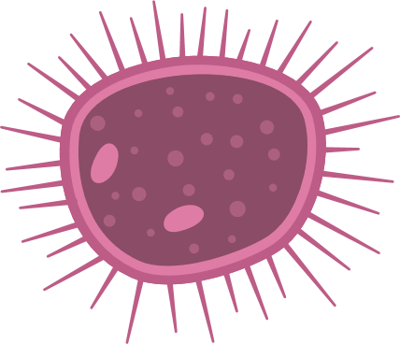
VIRUS
BACTERIA
ANTIGENS
dsDNA
ssDNA
RNA
POLLENS
MICROBIOME

Slide 21



MEN
WOMEN
PREGNANT WOMEN

Slide 22



KIDS
INFANT/BABY

Slide 23


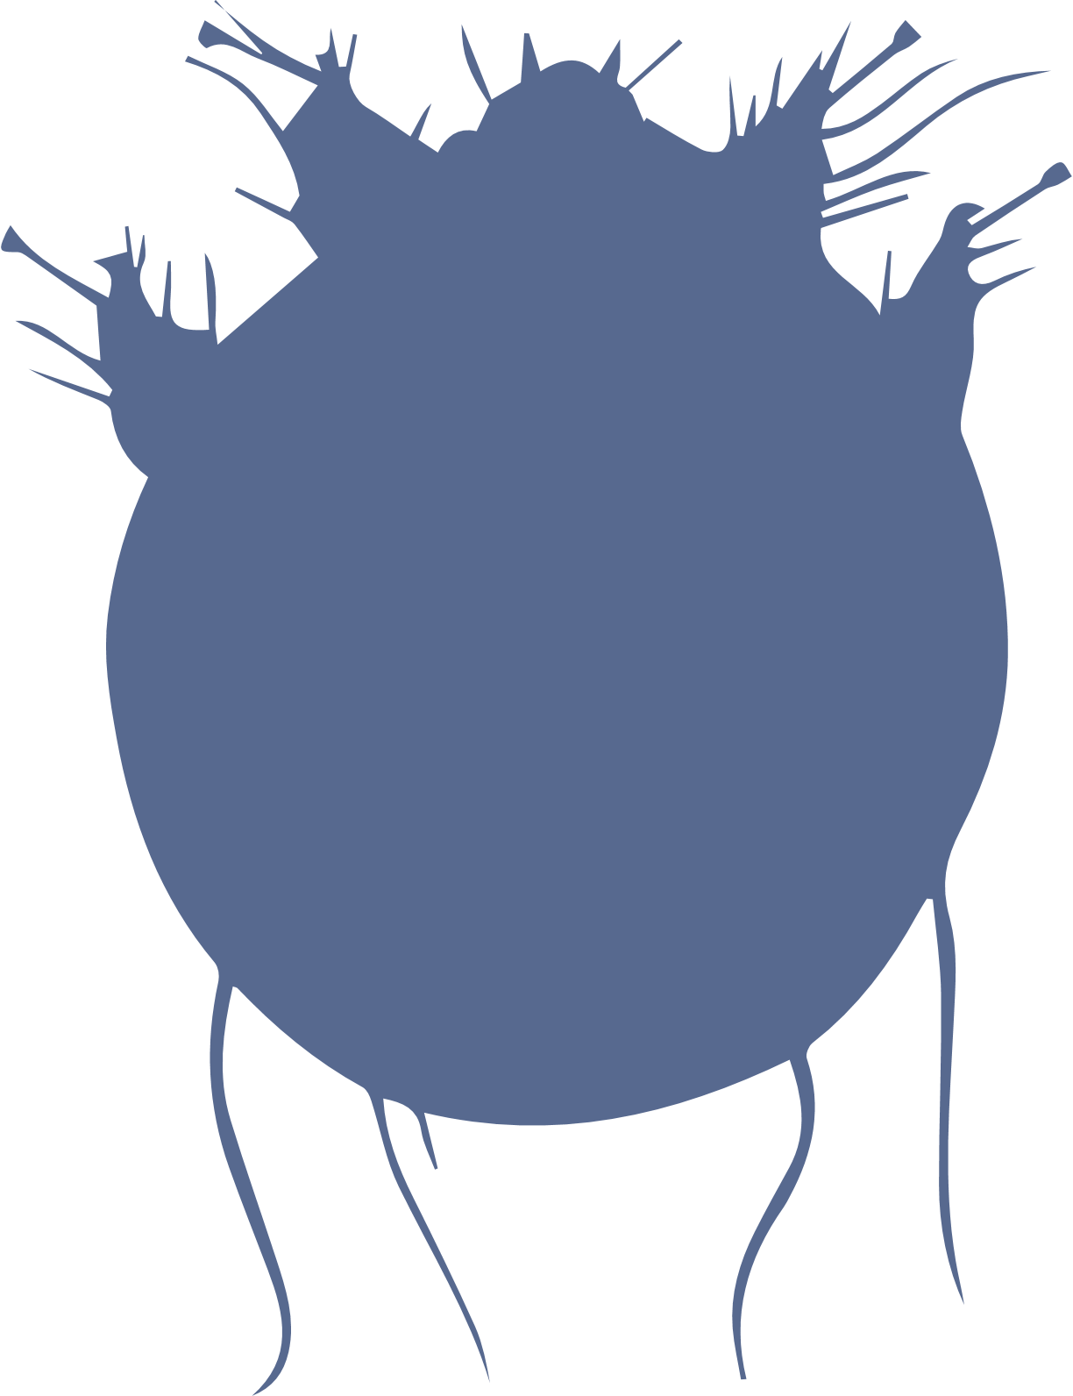
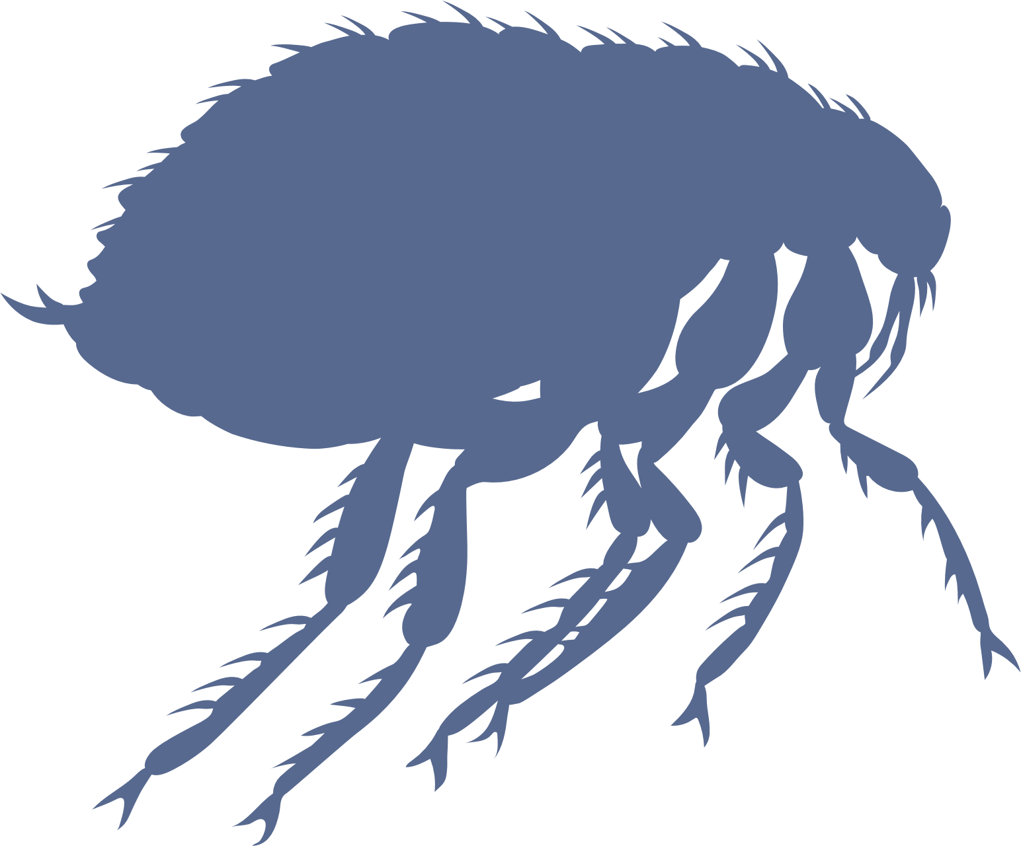

MOUSE
CAT
MITES
HYMENOPTERA

Slide 24


DOG
FISH
ALTERNARIA FUNGUS

Slide 25


TOBACCO
ENVIRONMENTAL

Slide 26
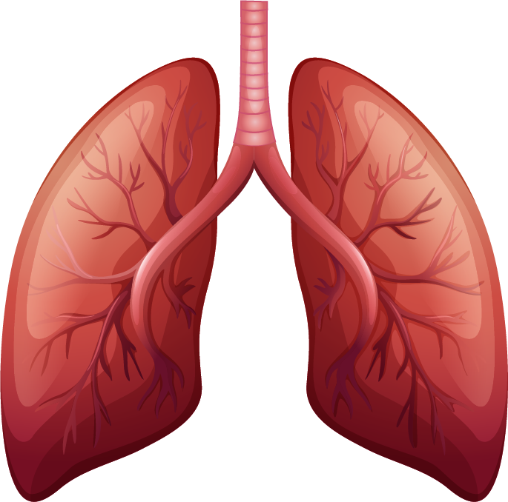
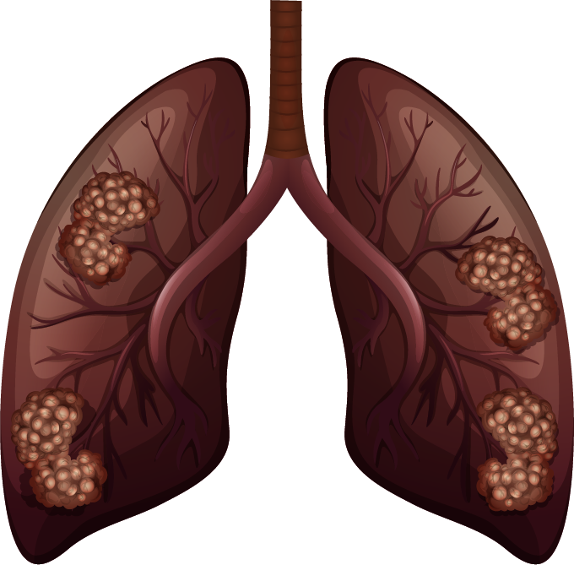
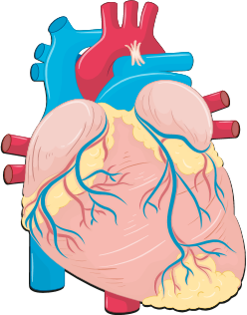
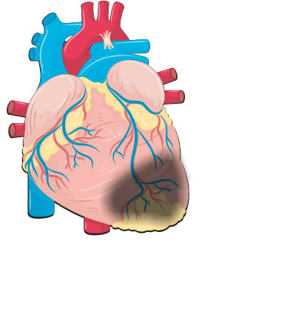
HEALTHY LUNGS
SMOKER LUNGS
HEART

Slide 27

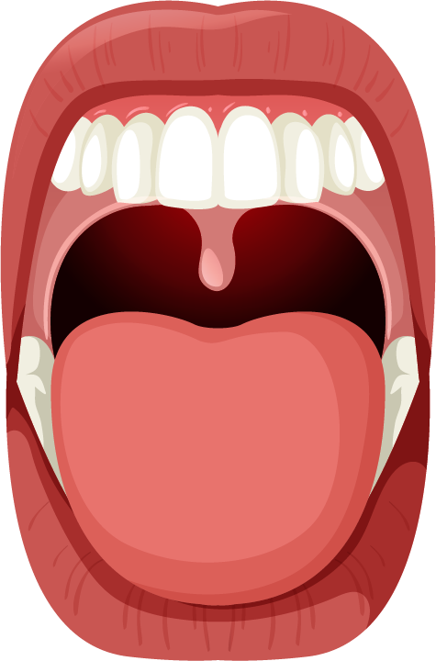
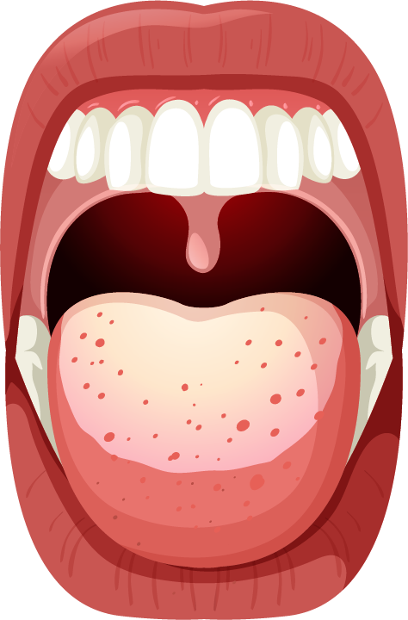
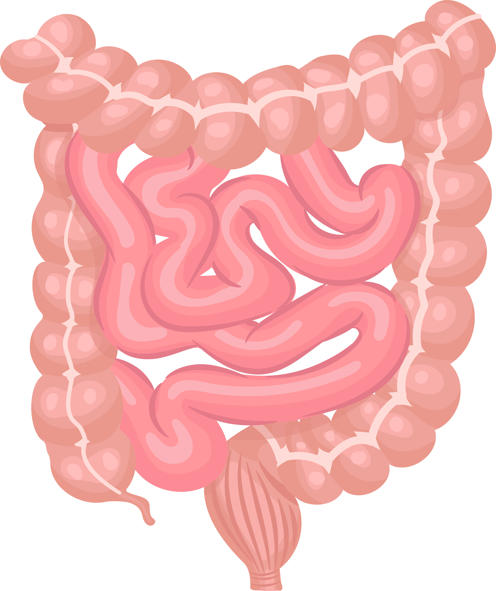
NOSE
ORAL CAVITY/OROPHARINGEAL DIGESTIVE TRACT
DIGESTIVE TUBE
NASAL POLYPS

Slide 28

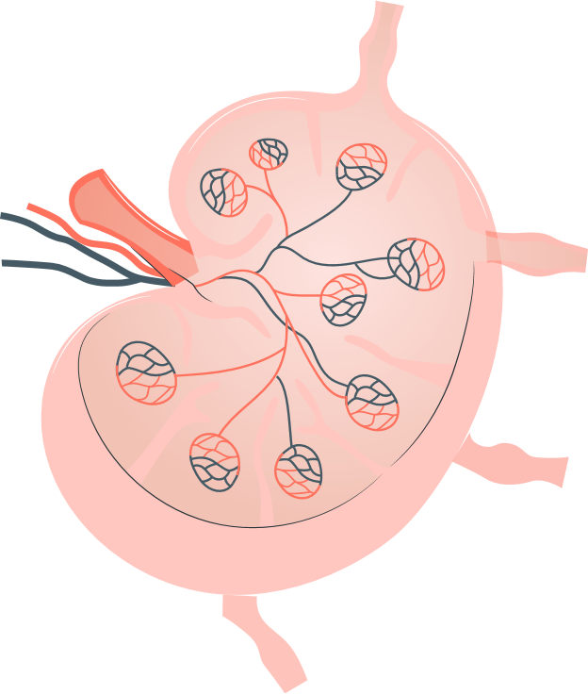
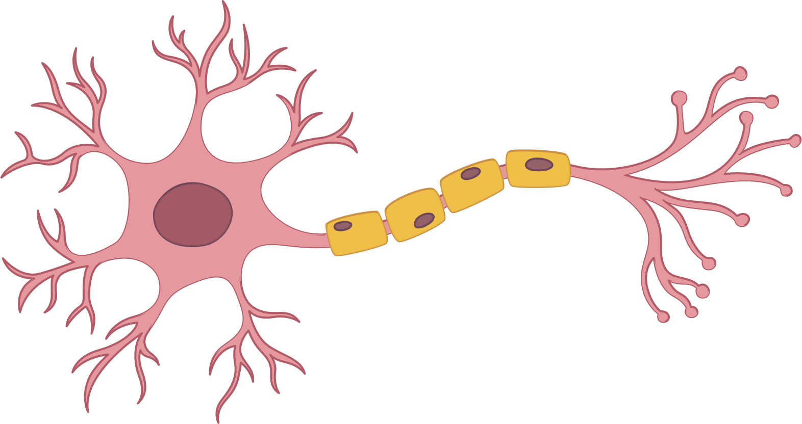
NEURON
NERVE
LYMPH NODE

Slide 29
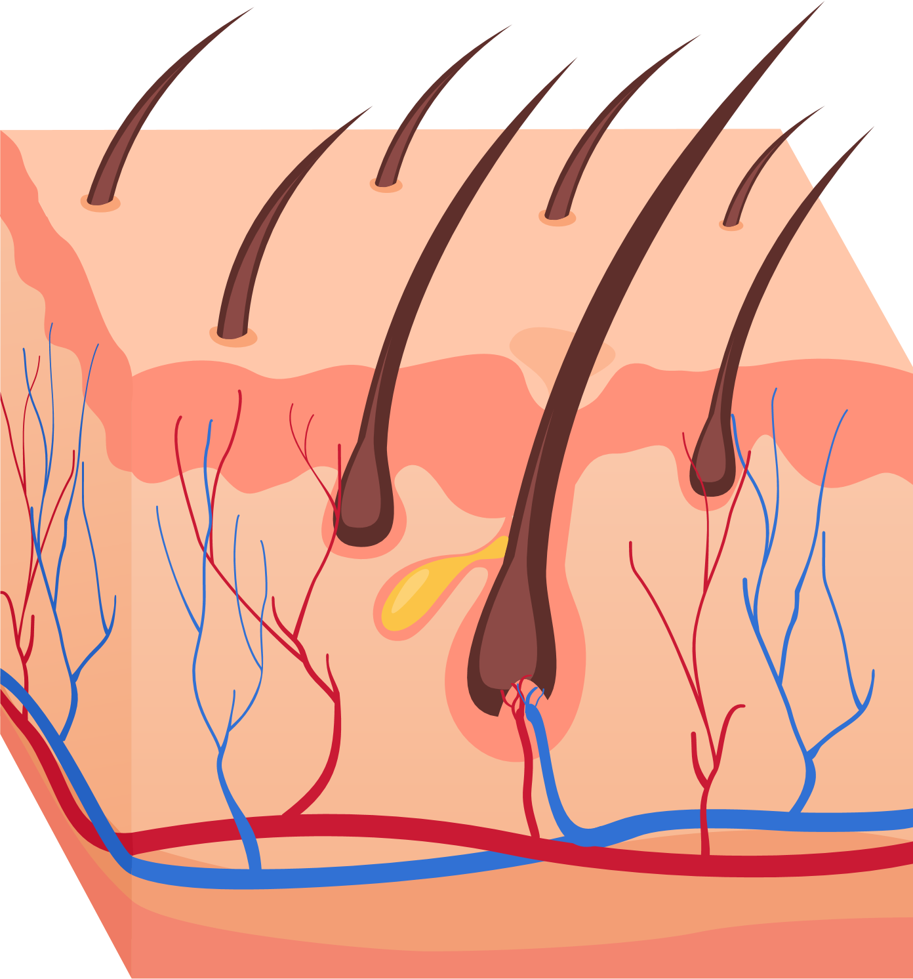
SKIN

Slide 30
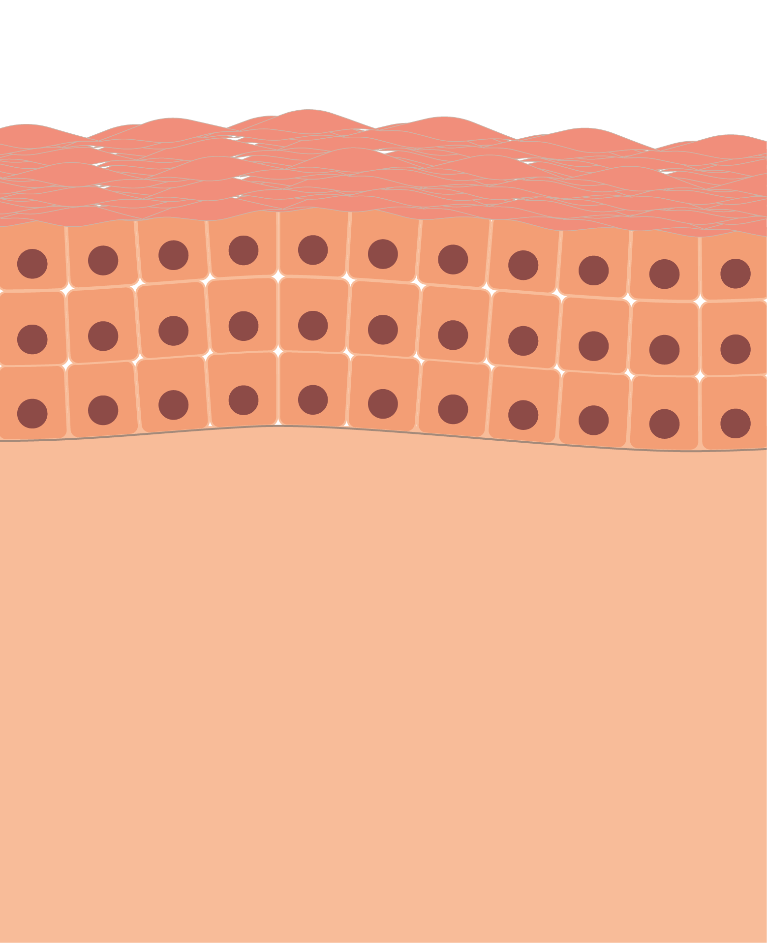
NORMAL SKIN

Slide 31
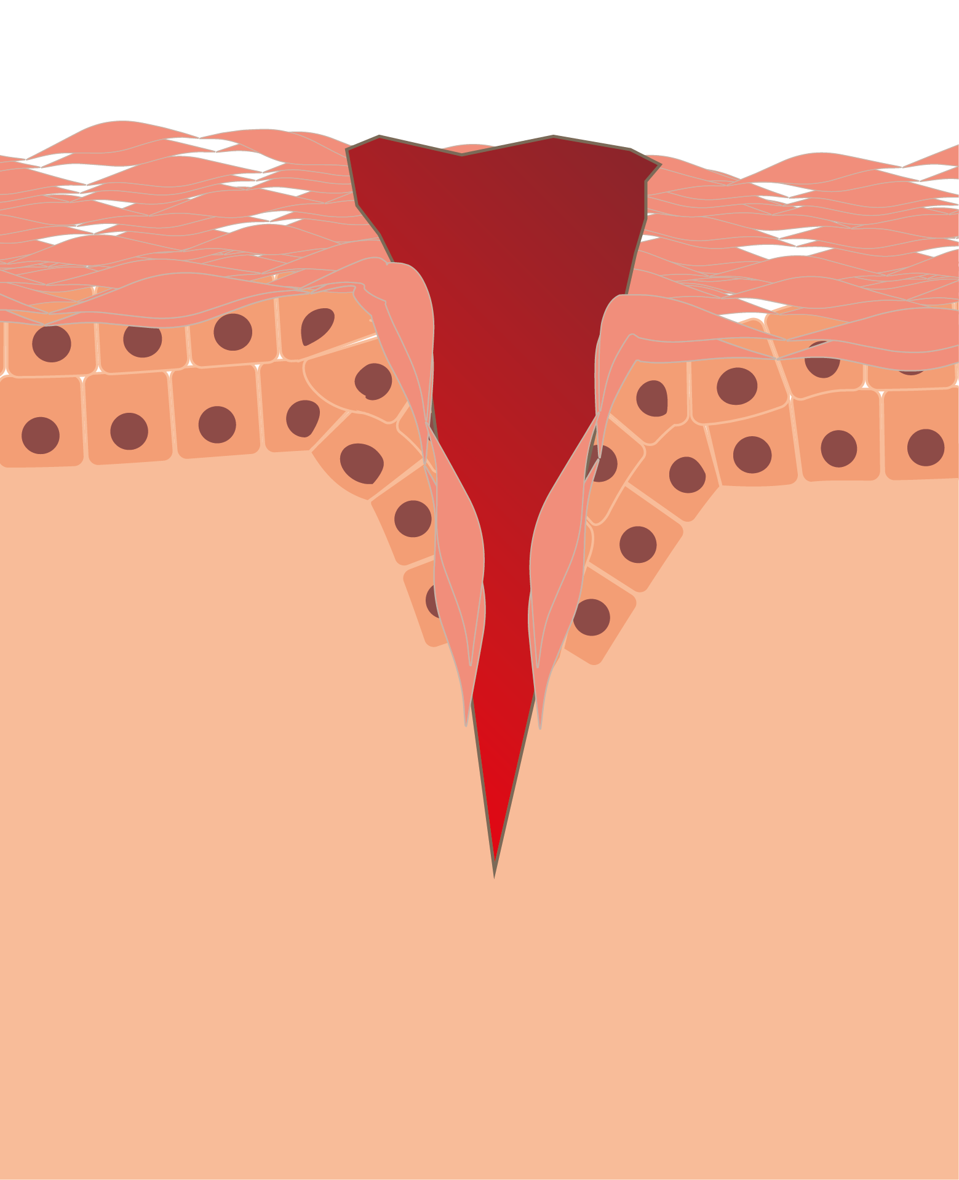
DAMAGED SKIN

Slide 32
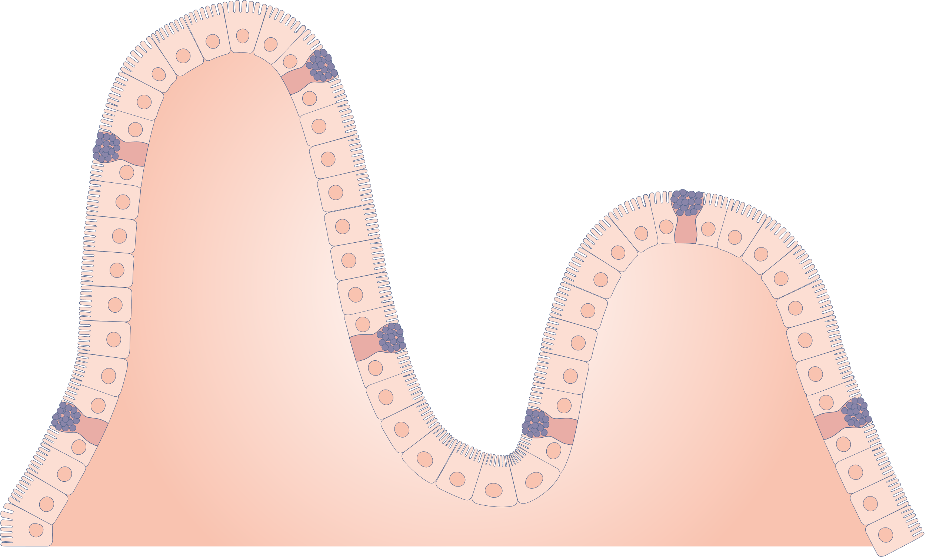
INTESTINAL EPITHELIUM

Slide 33
SCRATCHING

Slide 34
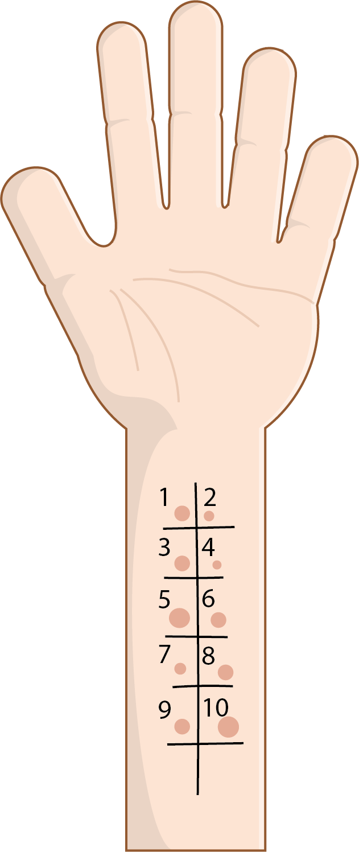
PRICK TEST
PATCH TEST

Slide 35




SYRINGE/VIAL
PILLS
AUTOINJECTOR
INHALER

Slide 36


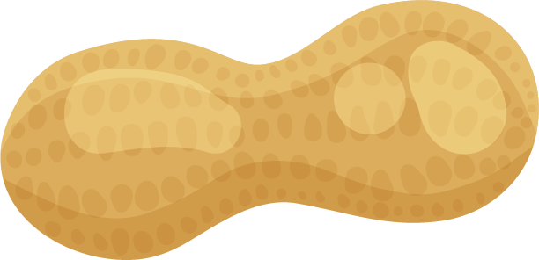




NUTS
FRUIT
MILK

Slide 37
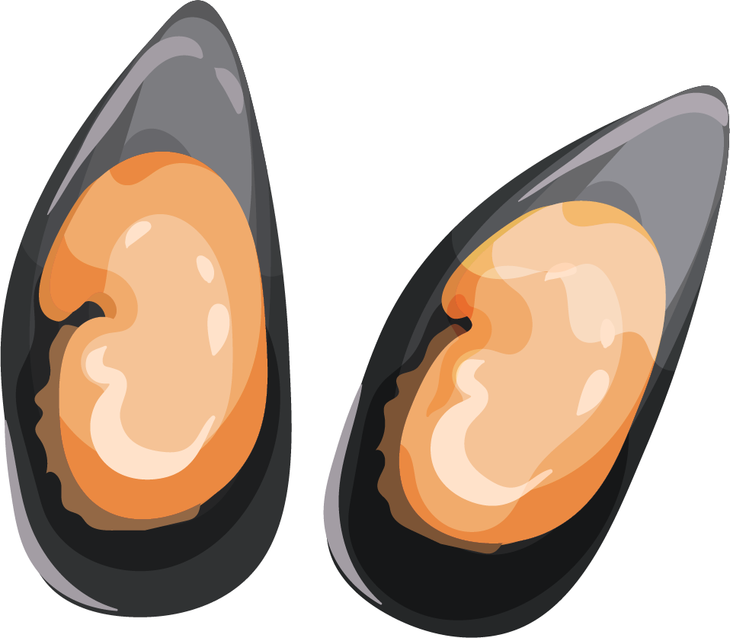

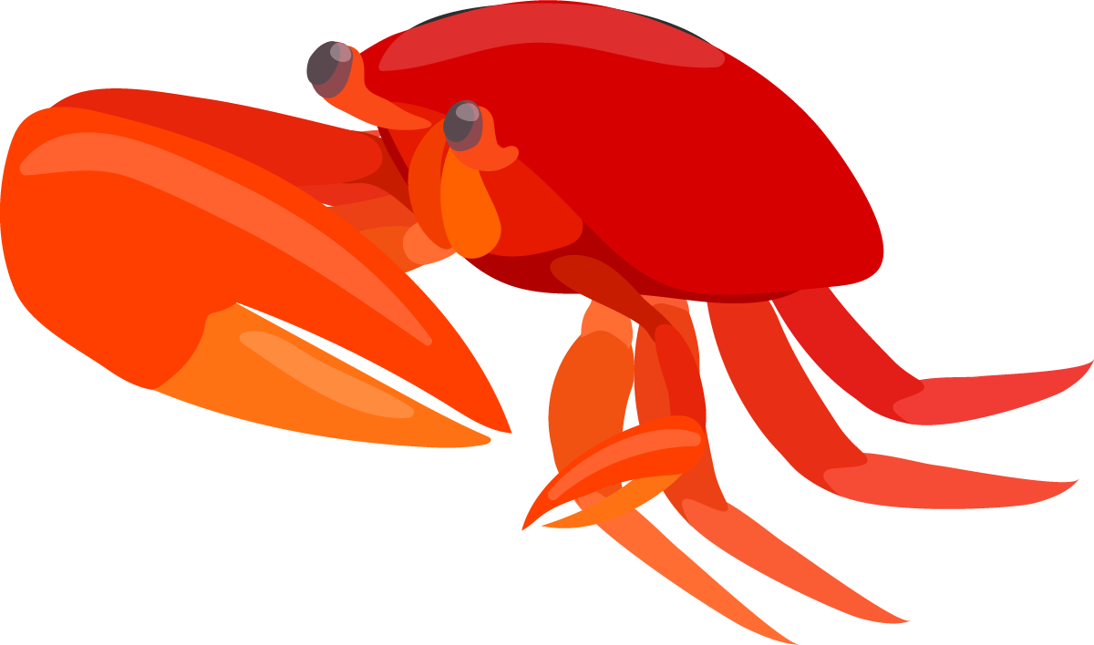
EGGS
LEGUMES
CRUSTACEANS
MOLLUSKS

Slide 38
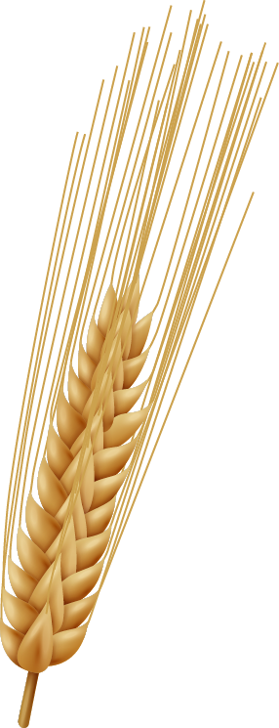

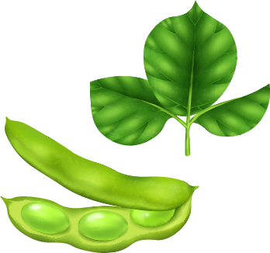





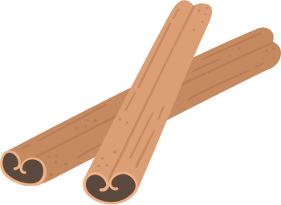

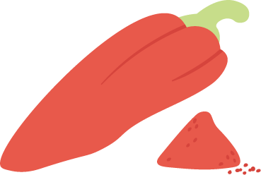
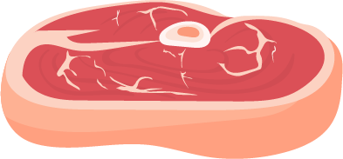


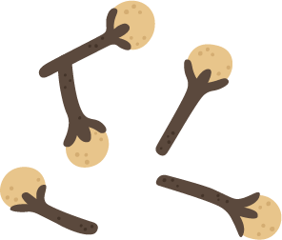
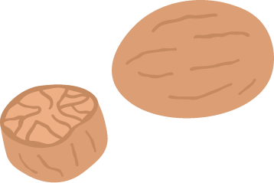
CEREALS
SOY
SEEDS
MEAT
SPICES

Slide 39



ACTIVATION
INHIBITION
DOWNREGULATION
SQUARES
UPREGULATION
CIRCLES

Slide 40
DID NOT FIND WHAT YOU WERE LOOKING FOR?
Please contact:
jiaci@jiaci.org

